Slide 1
AIR TICKET RESERVATION SYSTEM
PRESENTED BY
KEERTHANA R (15CSR083)
SUNMATHI P (15CSR215)
VISHALINI V (15CSR238)
GUIDED BY
K.DINESH

Slide 2
OBJECTIVES
The Main purpose of E-Air Ticket Reservation is to maintain customer and flight data.
This application allow Admin and User to do different operation like –
Customer Registration
Customer update
Flight search and booking
Cancel flight ticket

Slide 3
Scope of the system
The E-Air Ticket Reservation application is used by the Admin and User to perform the following functions:
LEVEL 0 USER- Administrator
Can create customer registration, Searching and booking of flight ticket.
LEVEL 1 USER – User
Can edit the customer profile and cancel the flight ticket. User can see the booking invoice.

Slide 4
Functional Requirements
Login Module
Customer Module
Booking Module
Logout

Slide 5
Non functional Requirements
UI Requirements
The front end should be user-friendly and pleasant
All entered values should be validated
Installation, Deployment & Operational Requirements
Needs Apache Tomcat server for deployment with MySQL 5.5 database for persistence
Should run on Windows or Linux platform.

Slide 6
Software System Requirements
an independent system ,implemented using J2EE technologies.
When a user connects to the Web Server, the Web Server will interact with the Database after processing the business logic to transfer data to and from a database.
Apache Tomcat 7.0 Web Server.
MySQL database for data storage

Slide 7
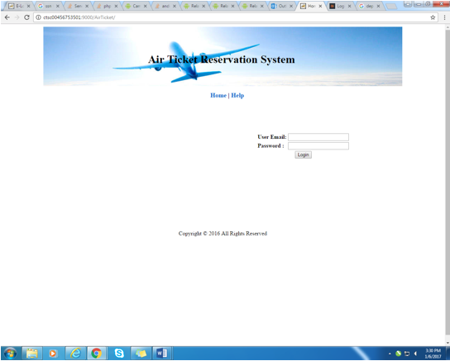
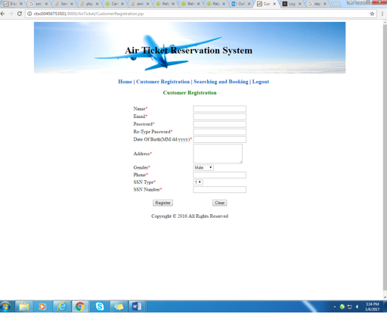
SCREENSHOTS
LOGIN
REGISTRATION

Slide 8
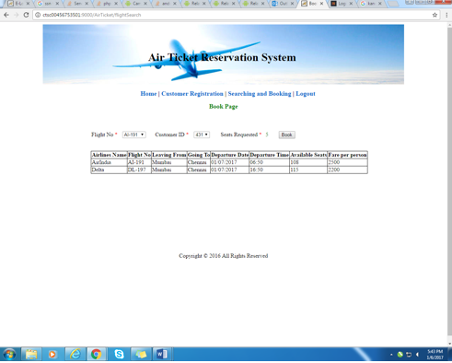

BOOKING PAGE
BOOKING INVOICE

Slide 9
THANK YOU

